Slide 1

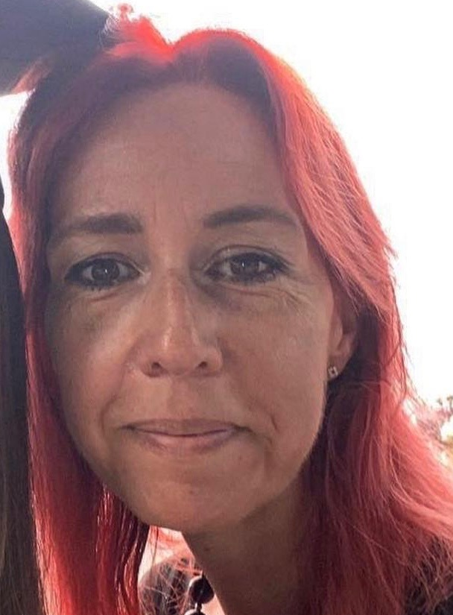
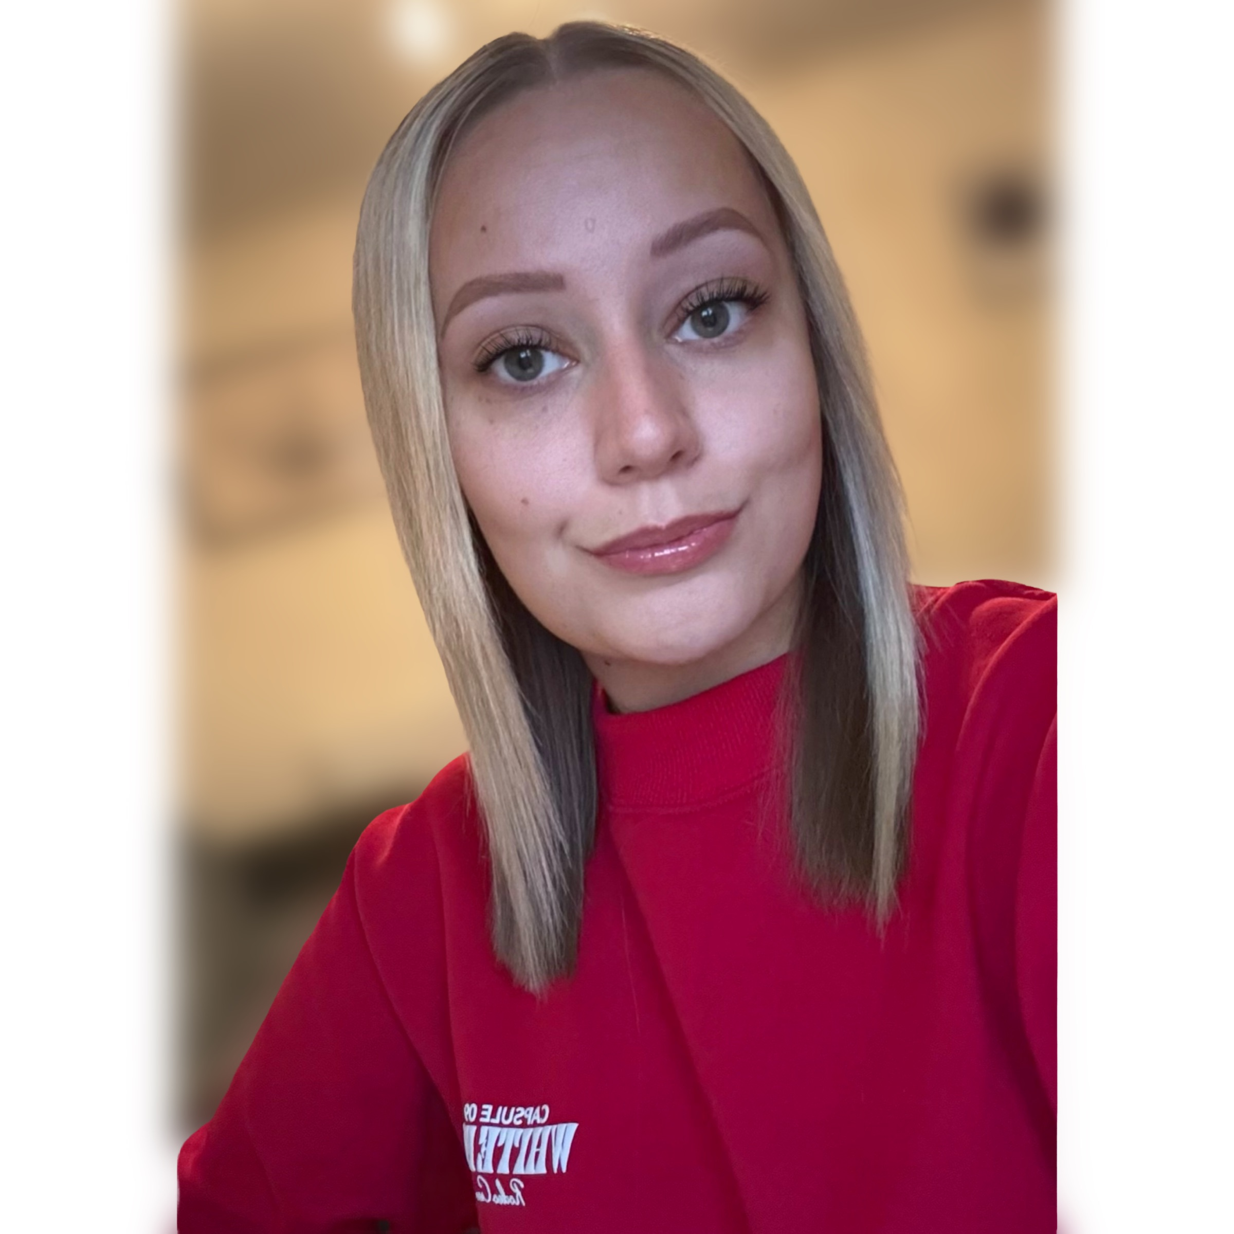
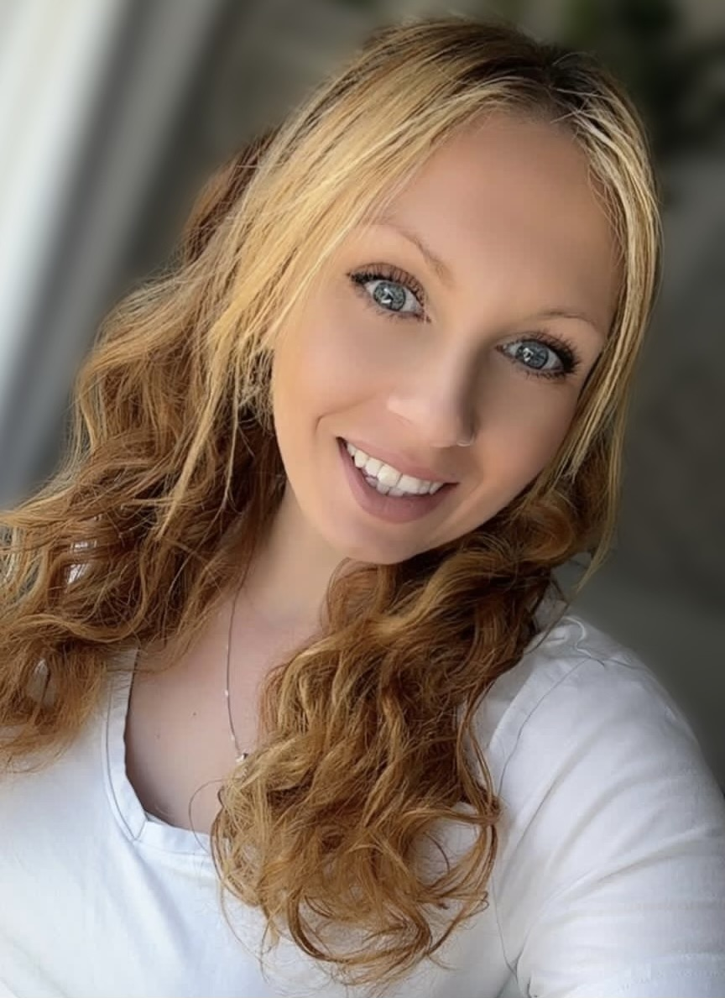
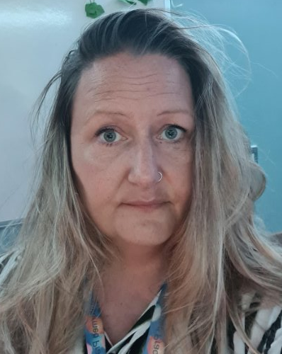
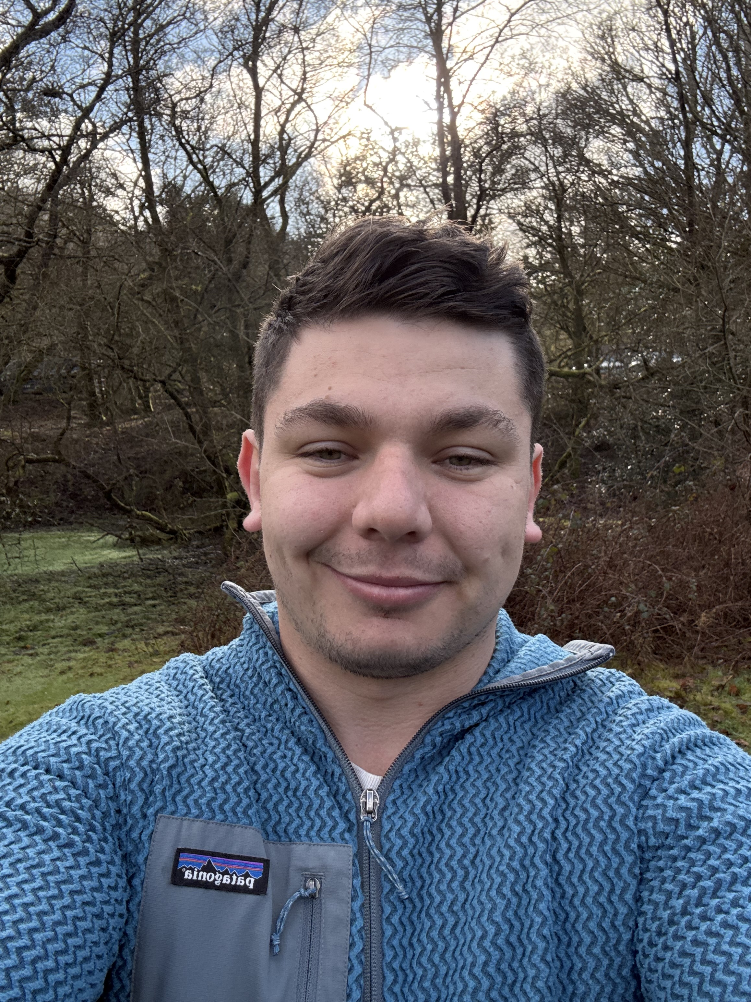
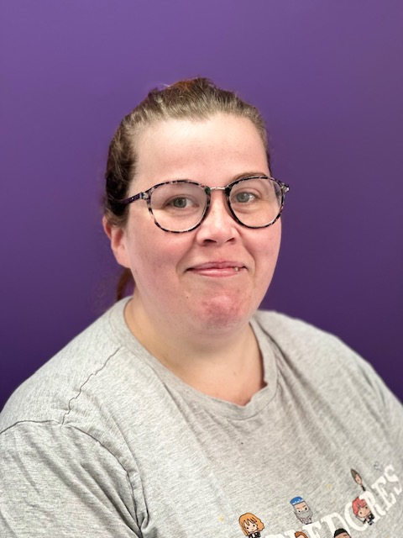
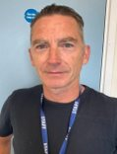
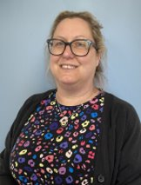
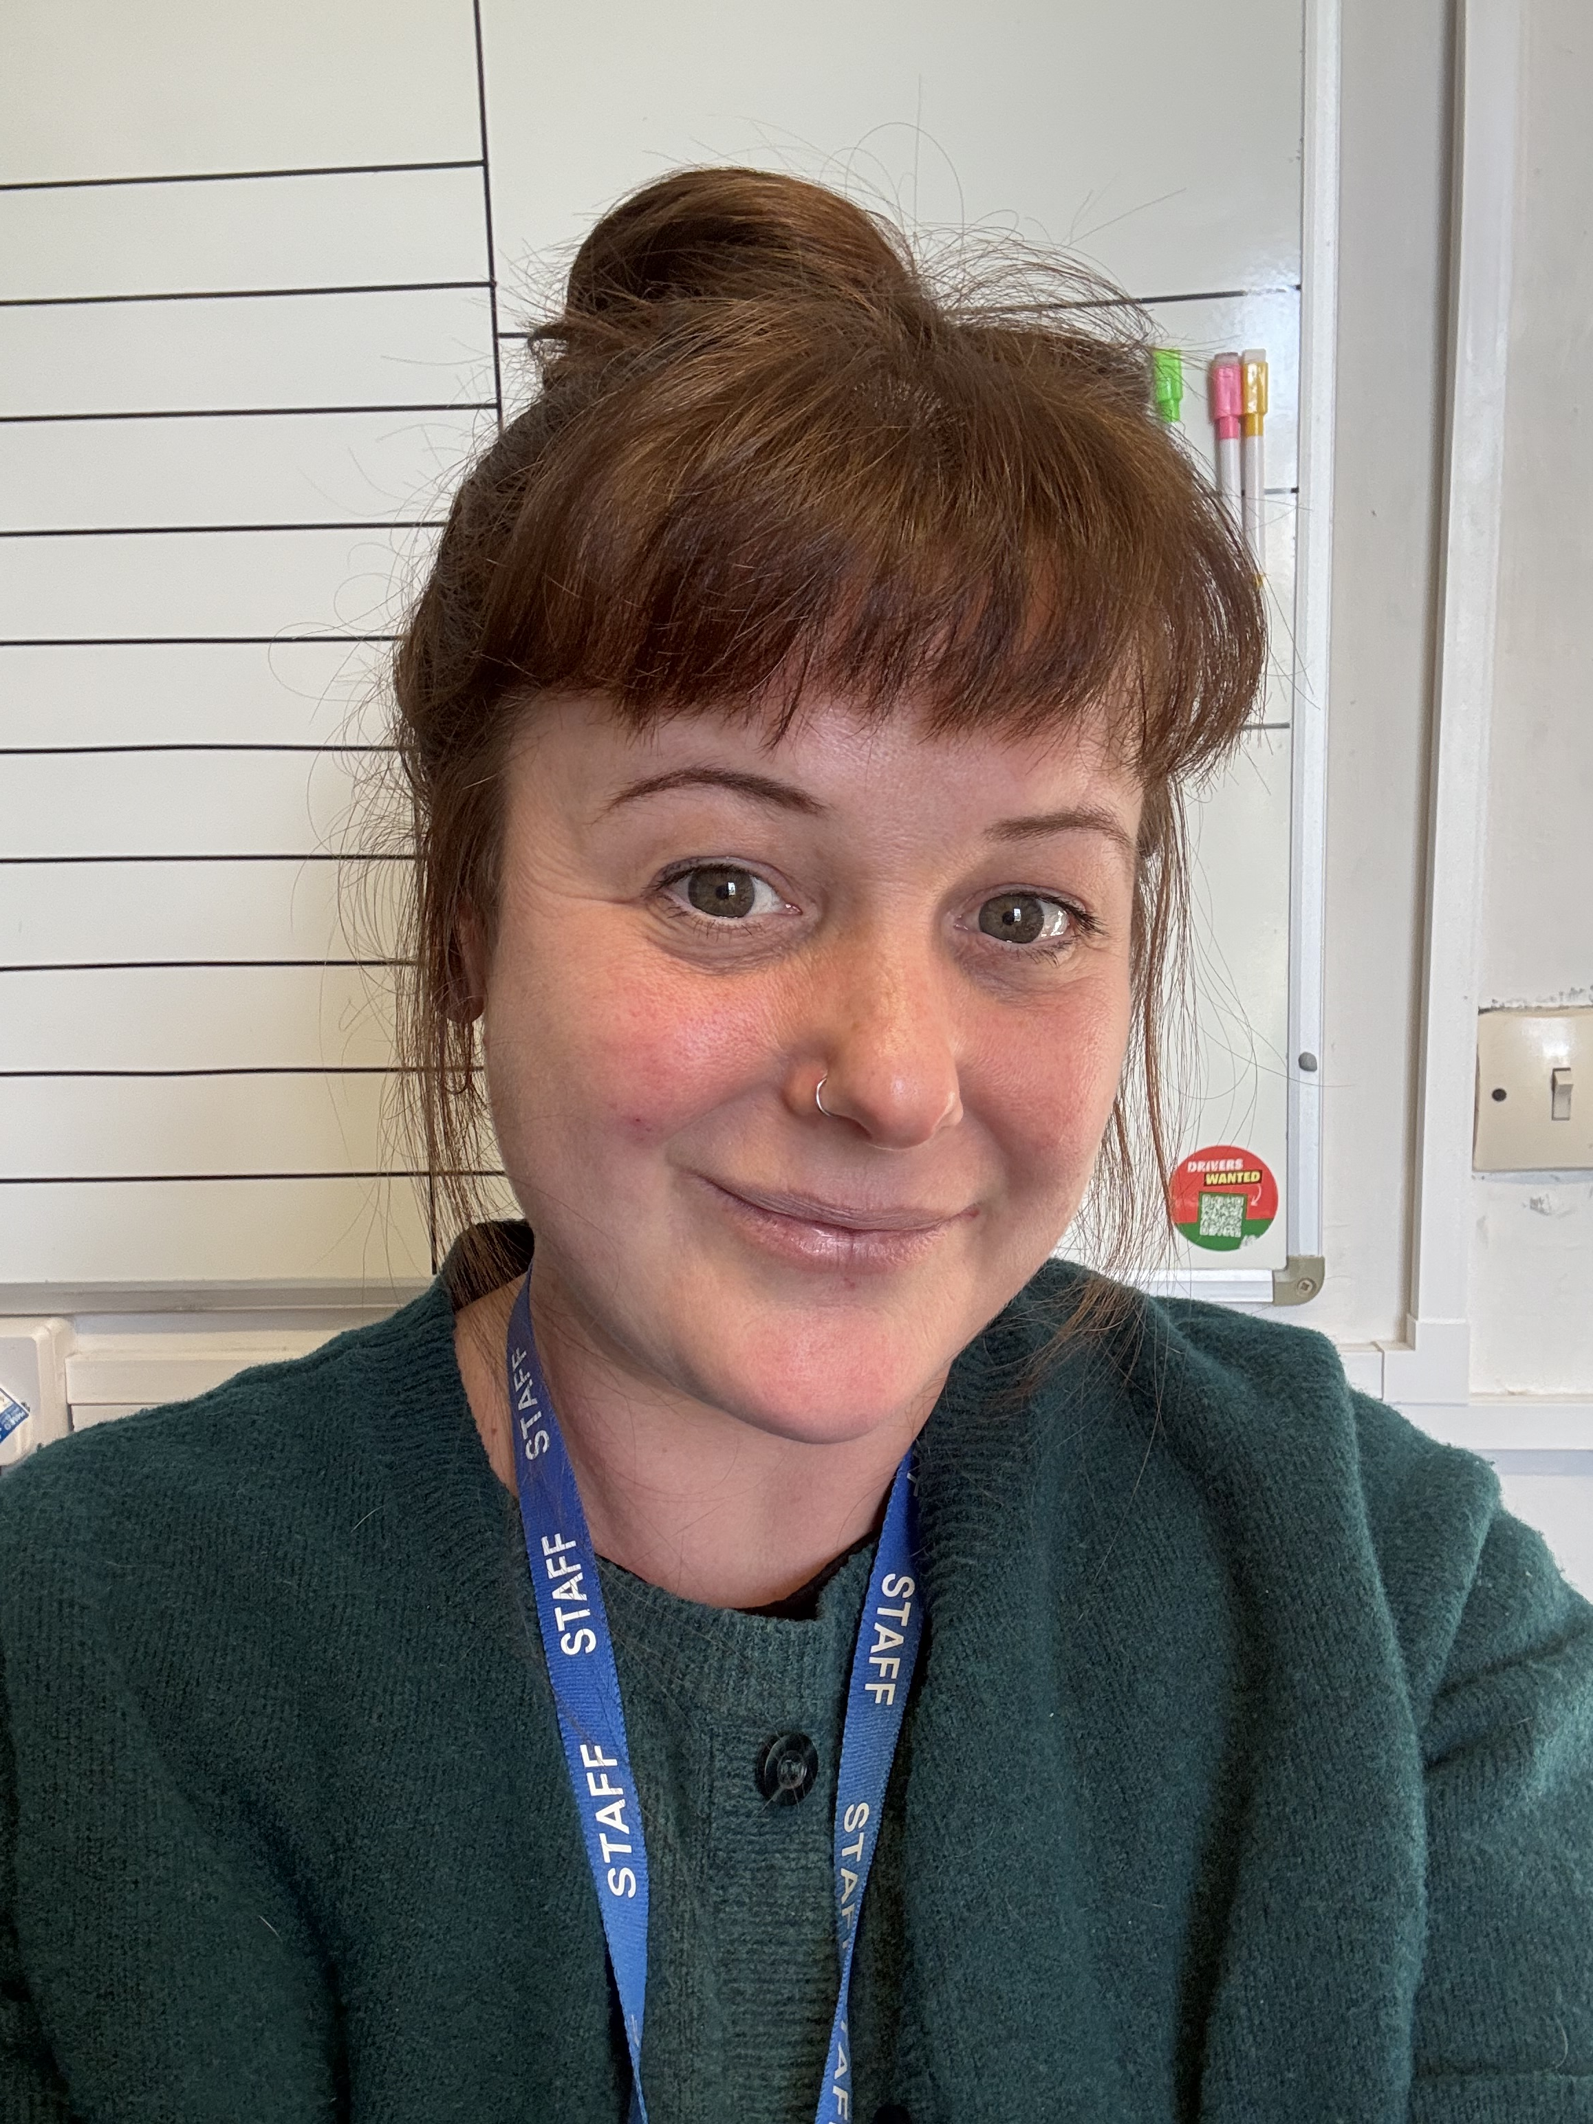
Mount Tamar Safeguarding Team
We strive to provide a safe and secure environment where our students are provided with appropriate education, support and guidance which promotes personal safety and well-being.
MASH Referral Services
01752668000 - ask for Children's Social Care, or mash@plymouth.gov.uk
Jenni Gordon
DSL
Laura Bolton
DDSL (Whole School)
Mel Battley
DDSL (Primary)
Shannon Fuller
DDSL (Secondary Row - Lane)
Dom Derrick
DDSL (Seymour)
If you are unable to contact any of the staff above, please speak to a member of SLT.
Cassie Lambert
(Primary)
Colin Bull
(Secondary)
Sam Payne
(Secondary)
Kerrie Pillans
(Seymour)

